Slide 1
Text Mining & Linguistic Analysis

Slide 2
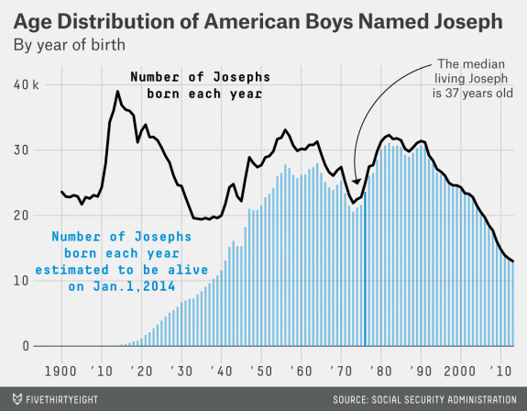
Text Mining & Linguistic Analysis
“Joseph has been one of the most enduring American names”
From description…
Notes:
http://babynames.dha.io/

Slide 3
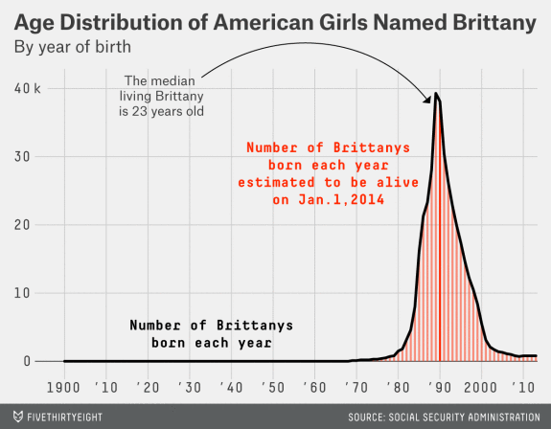
Text Mining & Linguistic Analysis
Popularity of the name “Brittany” peaked around the year 1990
From description…
Notes:
http://babynames.dha.io/

Slide 4
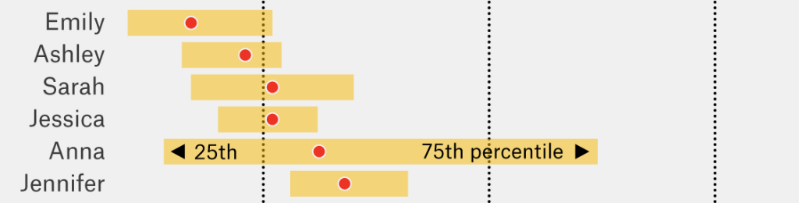
Text Mining & Linguistic Analysis
“How to Tell Someone’s Age When All You Know Is Her Name”
To prediction
Notes:
http://babynames.dha.io/
Other than Anna, narrow inter-quartile ranges
Oldest female name: Gertrude; one making a comeback after ~100 years: Violet

Slide 5
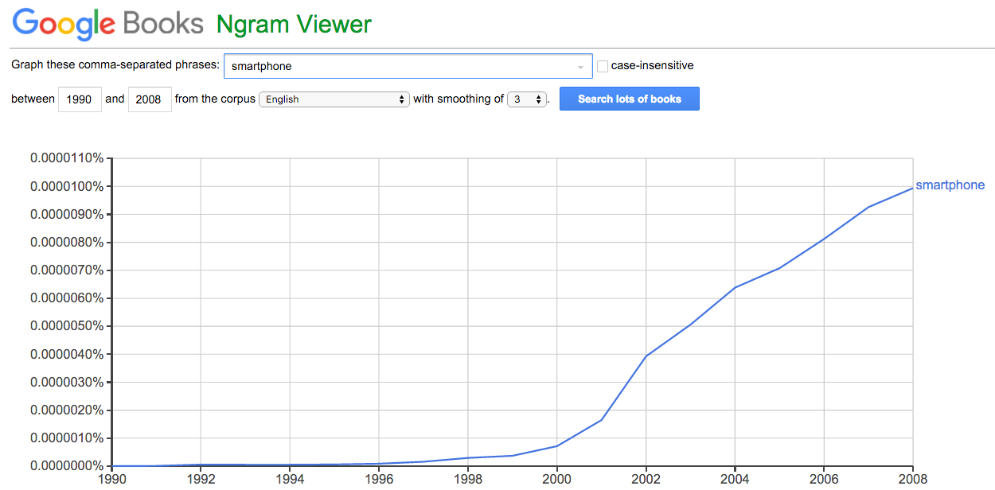
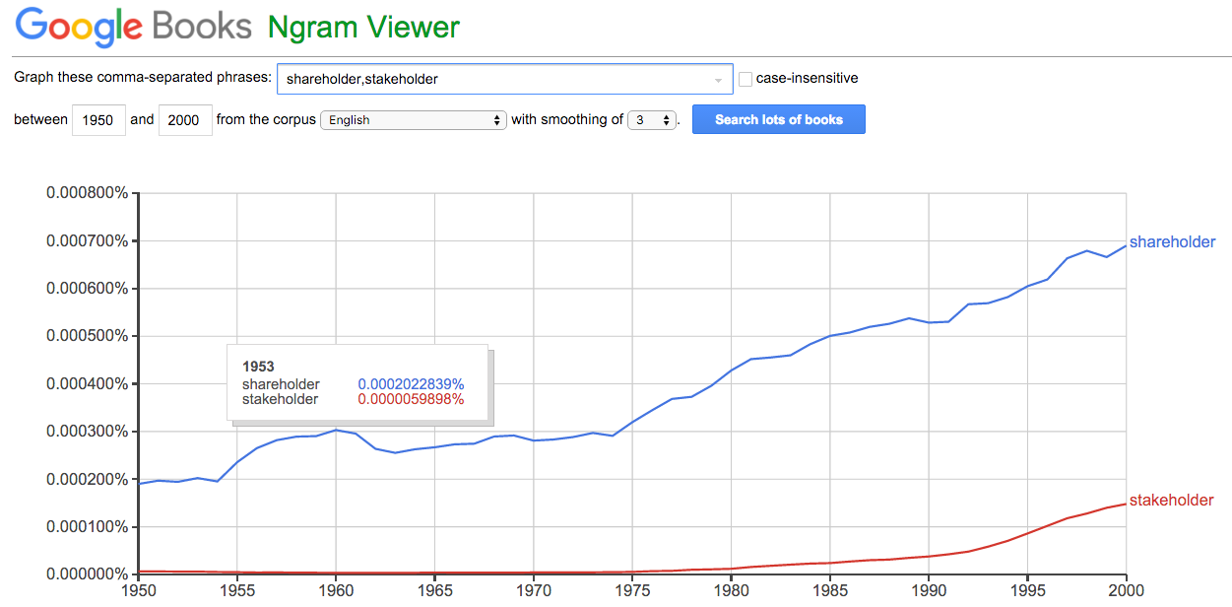
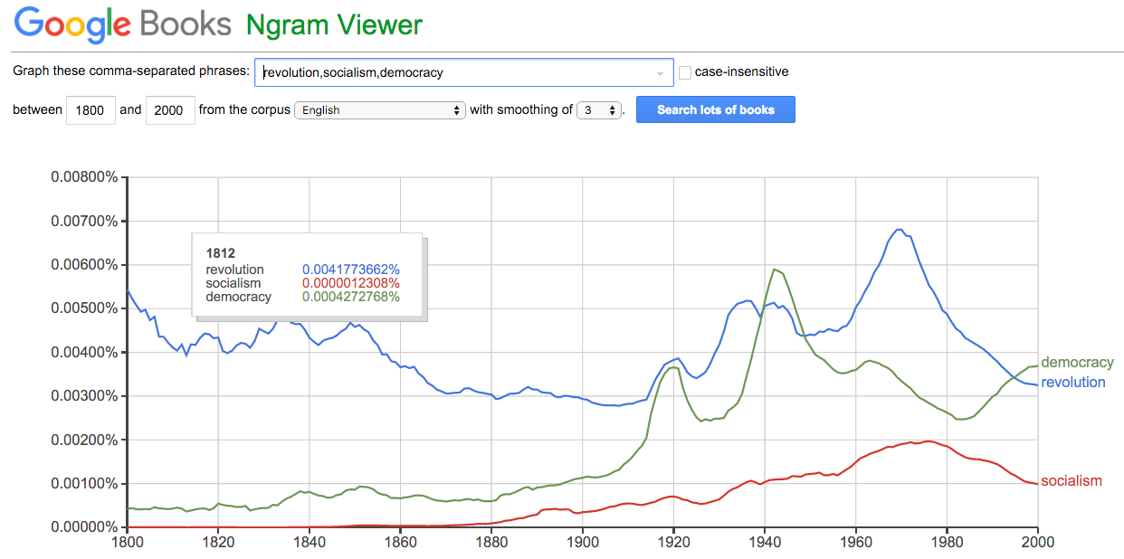
Text Mining & Linguistic Analysis
A simple search provides a great example of language change:

Slide 6
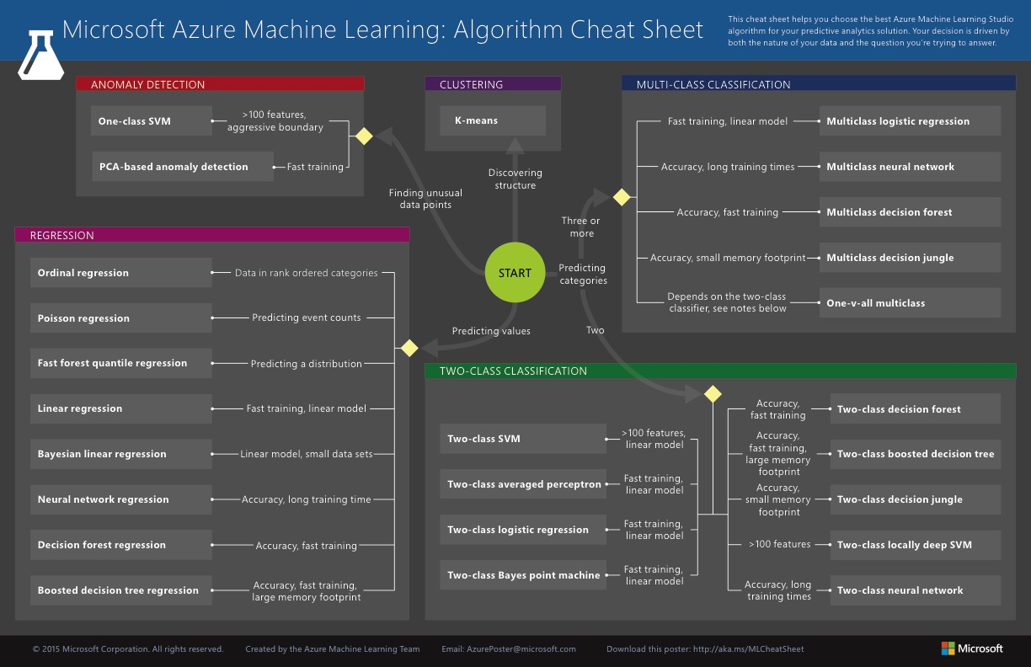
Text Mining & Linguistic Analysis
supervised
unsupervised
Much language-based analysis is unstructured and … exploratory

Slide 7
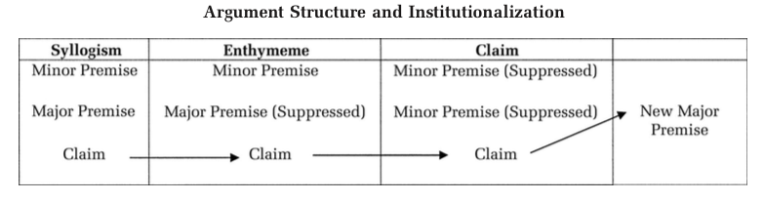
Text Mining & Linguistic Analysis
How we say something matters as much as what we say
Ex.: Green at al (2009): Adoption of TQM
Syllogistic logic (MinP [quality] : MajP (waste) : Clm [costs])
Q reduces W : W increases C : Q reduces C
(Quality)
(Waste)
(Costs)

Slide 8
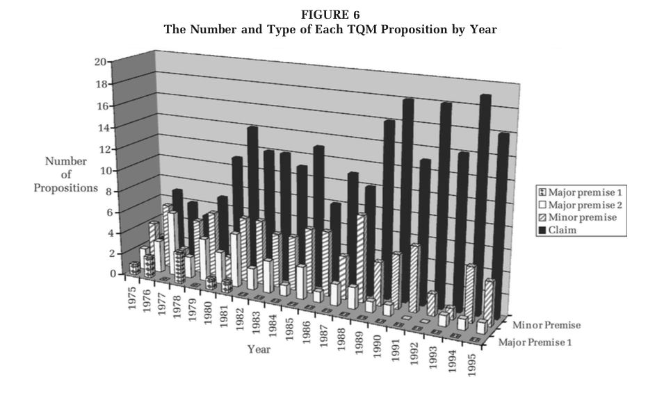
Text Mining & Linguistic Analysis

Slide 9

Text Mining & Linguistic Analysis
Language is a way of establishing (& perpetuating ) social consensus
Language ‘names’ what we see (or, notice)
Before describing anything, we first need to recognize it
Language devices make sense of the unfamiliar
Amazon analogies: browsing, shopping carts, checking out
The social conversation is fundamental to how we think and act
Mark Kennedy’s work on ‘social listening’

Slide 10
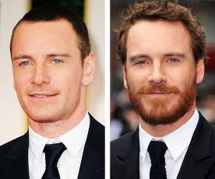
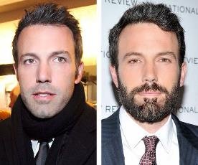
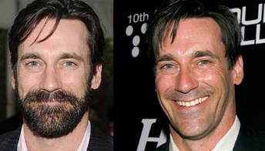
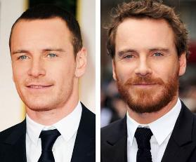

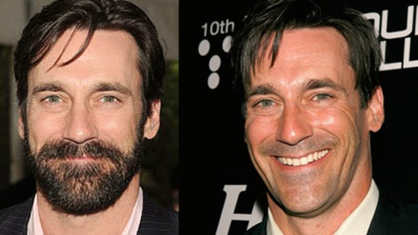
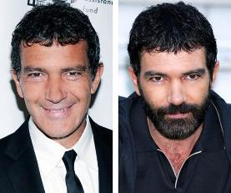
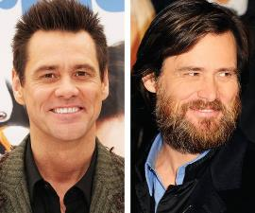
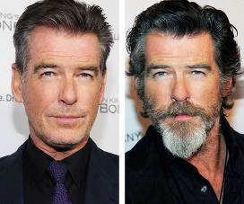
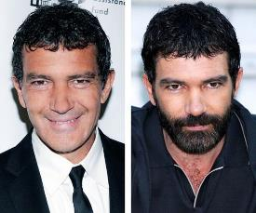

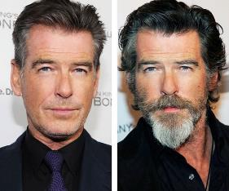
Text Mining & Linguistic Analysis
Fads & fashions are only the tip of the iceberg

Slide 11
Text Mining & Linguistic Analysis
The common denominator?

Slide 12
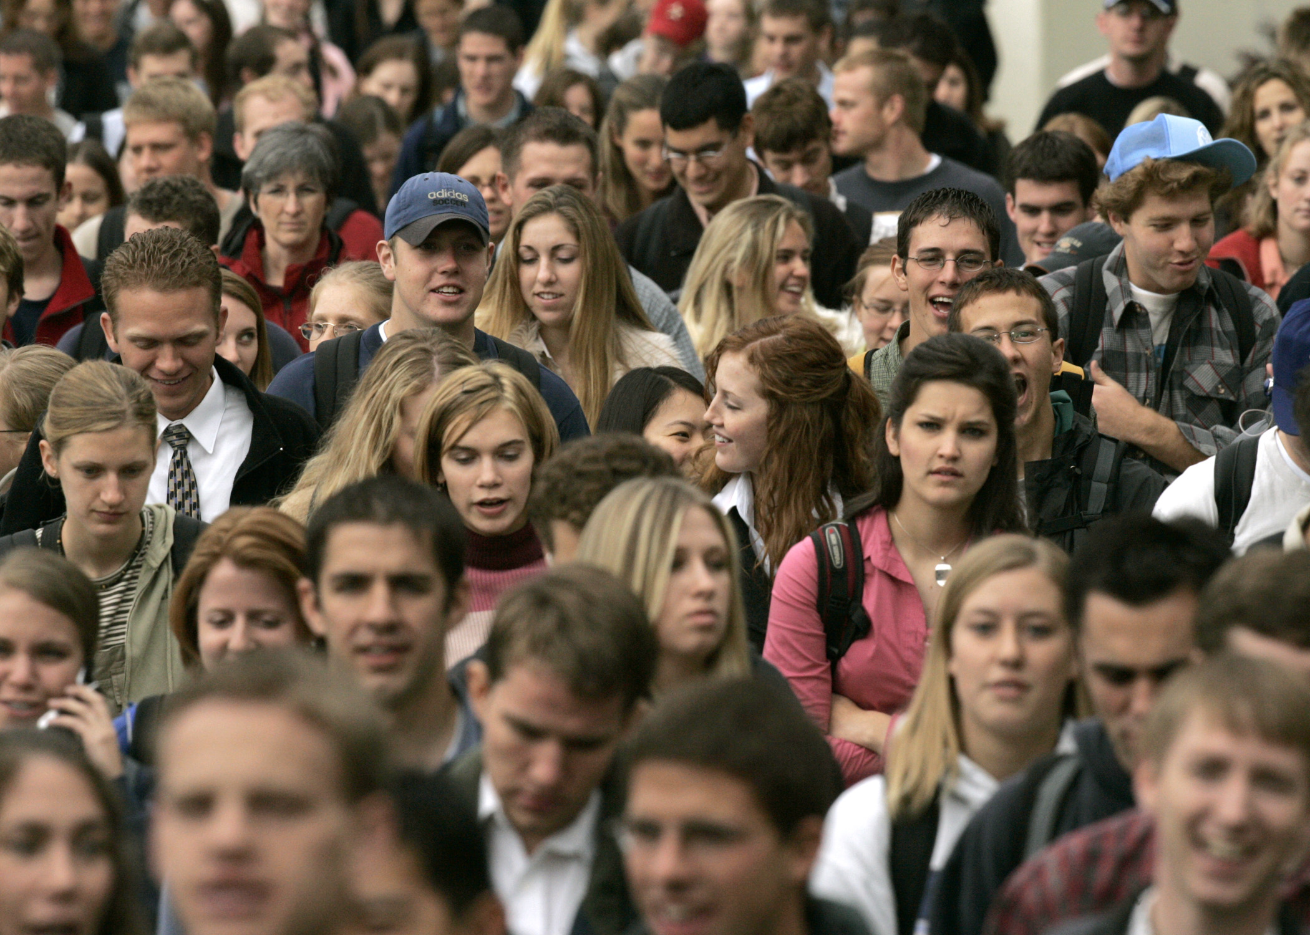
The social influence of crowds

Slide 13

Text Mining & Linguistic Analysis
So we use radical new tools to analyze crowd-level conversations (“social conversations”)

Slide 14
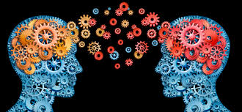
Text Mining & Linguistic Analysis
We find changes in shared mental models of a topic, not just volume or sentiment
e.g., for healthy behaviors, identify top-of-mind “underminers”—reasons why people fall short of prescribed standards

Slide 15
Why?
For example: “Concept car”
SUV
EV
car
van
van
SUV
truck
EV
car
cross-over
truck
sports car
cross-over
diesel
sports car
sedan
20 13
20 04
diesel
minivan
EV+
hybrid
hybrid
sedan
minivan
EV+
Because language use underlies social categories & market labels

Slide 16
Text Mining & Linguistic Analysis
There are different tools and techniques for linguistic analysis:
Entity tagging, relation extraction (NLP – Nat. Lang. Processing)
Topic Modeling (LDA – Latent Dirichlet Allocation)
K-means clustering and related methods
unsupervised

Slide 17
Questions?

